Slide 1
Loopholes Pack PLL Project
^{Texas Instruments Feedback}
^{Reed Adams}
^{09 May 2023}

Slide 2
Summary of Used Technology
65nm CMOS process
6 Metal Layers Supported
6 layers are used in this P&R
Layer 6 reserved for power routing

Slide 3
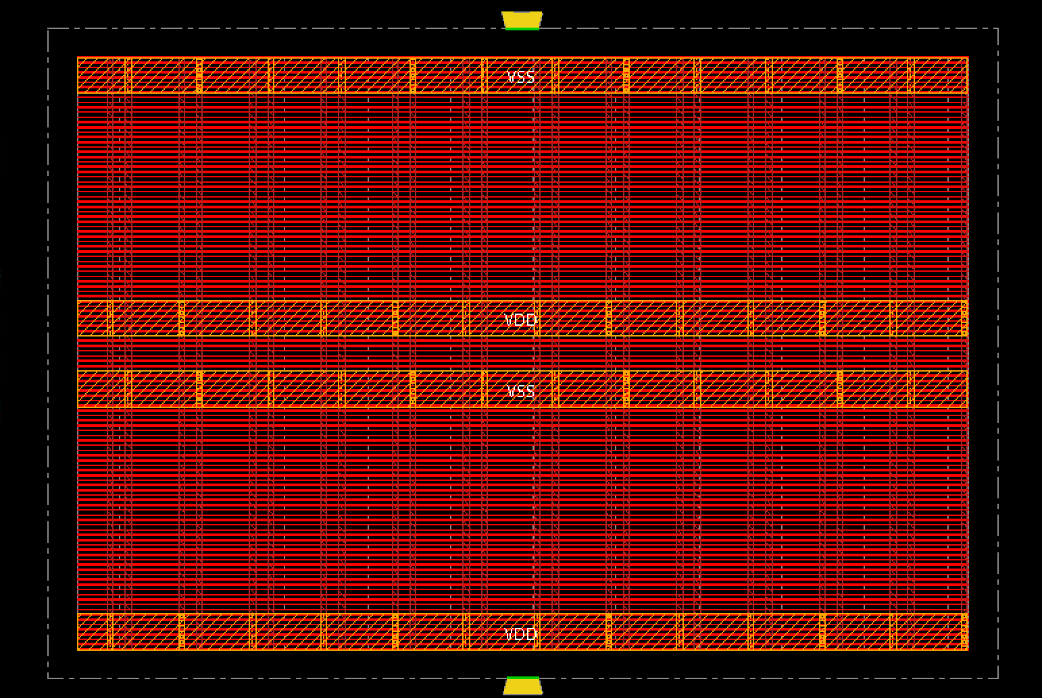
Snapshot of Loopholes Pack Floorplan

Slide 4
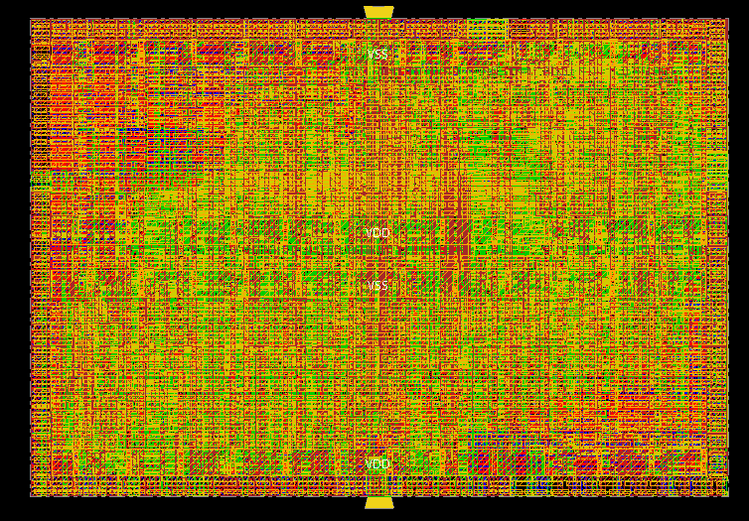
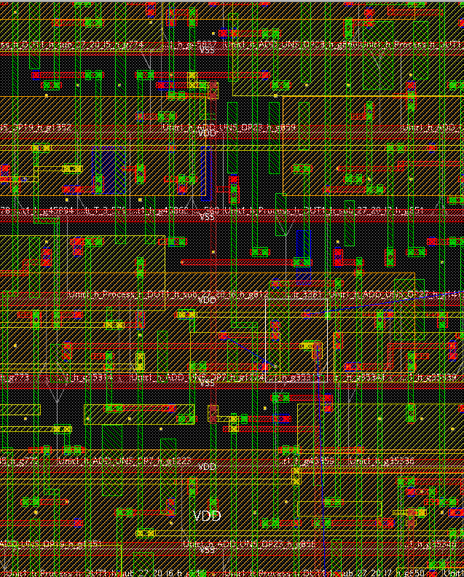
Snapshot of Loopholes Pack Final P&R
The Whole Layout
Magnified Portion of Layout

Slide 5
Area Information of Loopholes Pack Design
Gate Count | Layout Dimension | Core Density (Total Standard Cell Area/Total Core Area)
8076 | 300um x 200um | 52%

Slide 6
Comments from Texas Instruments
Design Overview
In simulation, we see no issue for the design to run at the full process capability.
The team provided us with their System Verilog design files. At TI, we processed their design through industry leading CAE tools that included our internal Synthesis and Place&Route offerings. This was conducted to provide the team a visual idea of what their design might look like in custom silicon if it was manufactured.
The results shown indicate that the design utilized a little over 8000 gates and would fit in a 200 um x 300 um (0.06 mm²) area with 52% routing efficiency. These results are for a 65 nm CMOS technology node.
By comparison, a traditional analog control loop of the same PLL function in this same technology node that includes an LC-Plant based VCO is approximately 0.5 mm².
This indicates the team has successfully implemented a fully digital frequency multiplication function that is traditionally performed using an Analog PLL in about 12% of the area, or an 86% savings in silicon real estate.
This area savings comes with tradeoffs. The most obvious is the resolution limitation in their ratio calculations and the final output drivers. The quantization noise generated will result in noise spurs around the target frequency that must be dealt with at a system level. Such spurs would be less obtrusive when utilizing a traditional analog control loop approach.
A pseudo-phase lock is achieved by periodically resetting the ring oscillator used in the design to re-synchronize it to the input clock. While never truly locked as a function of the architecture, their approach allows a reasonable approximation with an expected phase lag of roughly 20 ps – 40 ps in a 65 nm CMOS process.

Slide 7
Comments from Texas Instruments
Design Implementation
The selected architecture is unique in that it does not mirror the traditional Analog PLL. The design was implemented using a series of measurements of various clocks to determine frequency ratios of those clocks. The ratios were then processed through ALU-type functions to determine appropriate divider values. The signal path is purely feed-forward in this team’s implementation. Filtering of that feed-forward path was implemented to achieve a proper average frequency over an extended time window.
FPGA vs Silicon Performance
The selected FPGA was chosen primarily based on the number of logic elements available. In hindsight, the teams learned that a few other specs should have been reviewed. As a result, during lab implementation on the FPGA, it was discovered that the frequency of the FPGA is limited. The ring oscillator, for example, can only run up to about 200 MHz. Some of this limitation may be caused by the connection paths that are formed inside the FPGA when it is programmed. As a result, the outputs demonstrated are slower than desired on the FPGA.
For a custom silicon implementation in a 65 nm CMOS technology node, I am unable to disclose propagation delays of individual gates or setup/hold times of flip flops, nor similar specifics. This directly relates to our technology node capability, which is considered proprietary. However, I can comment that in this process, after an internal review, we expect this team’s design implementation to consistently provide an output frequency capability in excess of 1.25 GHz synchronized to the input clock over all process, voltage, and temperature corners.

